Slide 1
Deep Learning for Radiological Image Processing
Authors: Mohannad Hussain & Marc Kohli
Society for Imaging Informatics in Medicine
Presented by: Allyson Warren & Leslie Cook

Slide 2
What is the Goal
Deep Learning algorithms have the potential to give higher accuracy in identifying abnormalities in radiological images than the human eye
In this project, the goal is to classify sagittal T1 MRI scans by pre- and post-contrast
Sagittal describes how the body (brain) is divided into left and right halves
TI is the time constant that determines the rate at which excited protons return to equilibrium
Sagittal T1 MRI’s show nerve connections of white matter to appear white, congregations of neurons of gray matter to appear gray, and the cerebrospinal fluid to appear dark

Slide 3
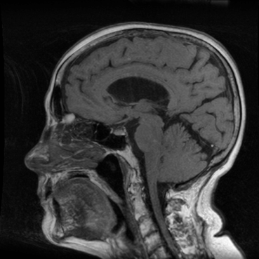
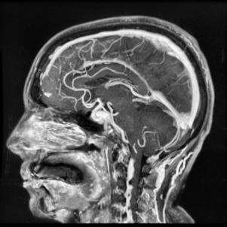
Pre-contrast Post-contrast

Slide 4
Dataset and what it is
Given two folders: Train and Test
Need to split images into training, validation, and test sets
Training Dataset
Train/with_gad : contains sequences with contrast
209 items, 22.7 MB
Train/no_gad : contains sequences without contrast
695 items, 88.2 MB
Testing Dataset
Test/with_gad : contains sequences with contrast
118 items, 11.4 MB
Test/no_gad : contains sequences without contrast
445 items, 40.9 MB

Slide 5
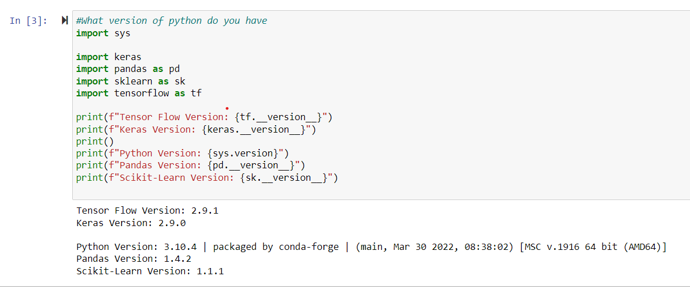
Virtual Environment and System Requirements

Slide 6
Library Requirements
sys : system specific parameters and functions
matplotlib : data visualization library in Python (plots, graphs, stats)
pyplot : matplotlib’s plotting framework
numpy : library for large scale mathematical operations
tensorflow : library used in neural networks for dataflow programming across a range of tasks.
keras : high-level API of tensorflow, highly-productive interface for solving DL problems
sklearn : machine learning library of tools for predictive data analysis
os : module to interact with underlying operating system
itertool : collection of tools for handling iterators (data types used in for loops)
Notes:
API: Application Programing Interface: software intermediary that allows two applications to talk to each other

Slide 7
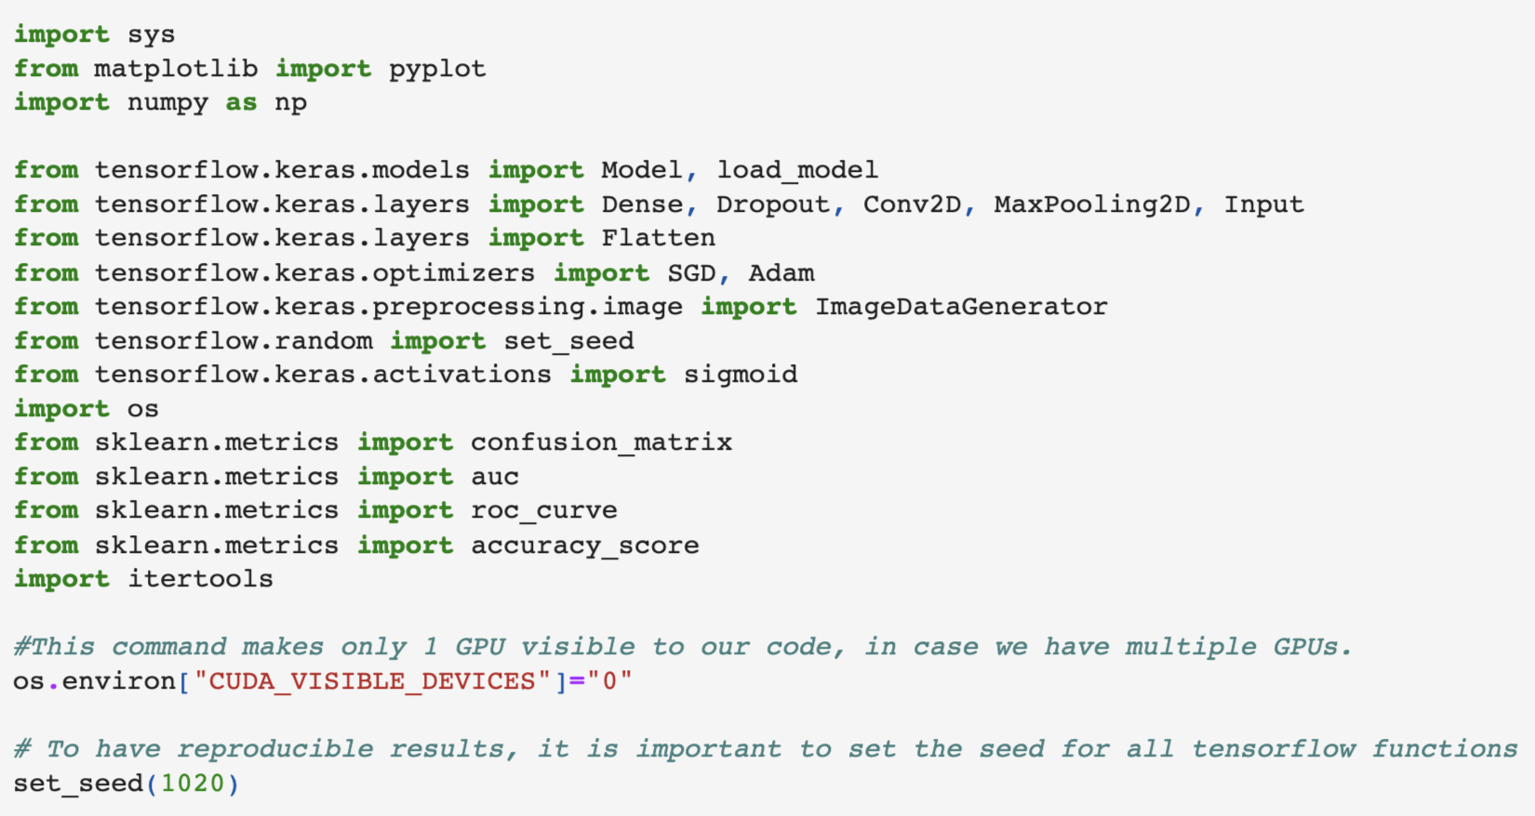
Importing the Libraries
Setting the seed is starting point for generating random numbers
Important for reproducible results
Keras ustilizes NumPy random number generator with tensorflow backend

Slide 8
Importing the Libraries
tensorflow.keras…
.models : allows us to build and load the model into our neural network
.layers : equips the model with a series of layers to process the images
.optimizers : gradient descent algorithms to learn the best params
.preprocessing.image : data augmentation of images in real time while the model is training
.activations : classification function
sklearn.metrics…
import confusion_matrix : technique to calculate the performance of classification
import auc : computes area under the curve
import roc_curve : plots the rate of true positives and false positives for a binary classifier
import accuracy_score : computes the accuracy of the count of correct predictions

Slide 9
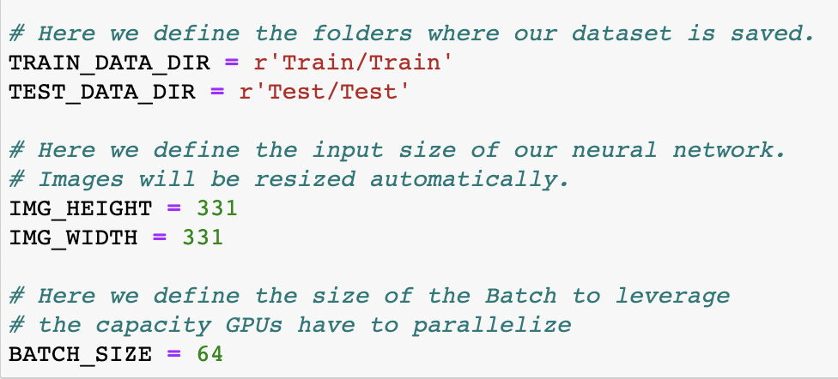
Variable Configuration
Define the folders where the dataset is saved
Define the input size of our network
Define the size of the batch to leverage
DataGenerator functions will fetch the files, automatically resize the images, and set the capacity GPUs have to parallelize.
Notes:
Batch: allows for computational speedups, number of samples processed before the model is updated

Slide 10
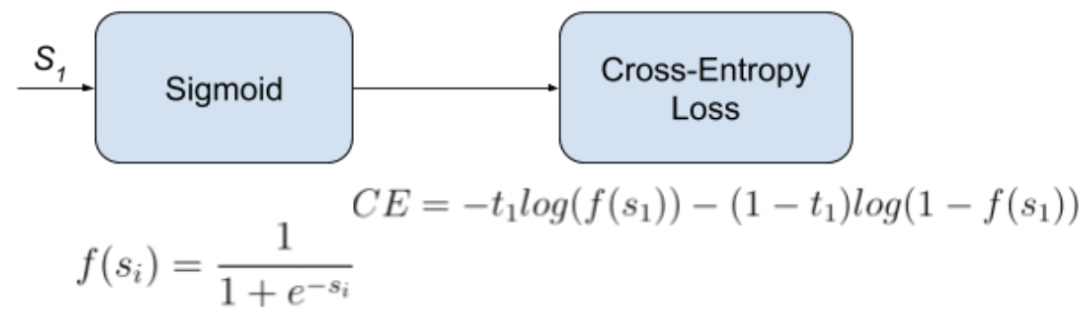
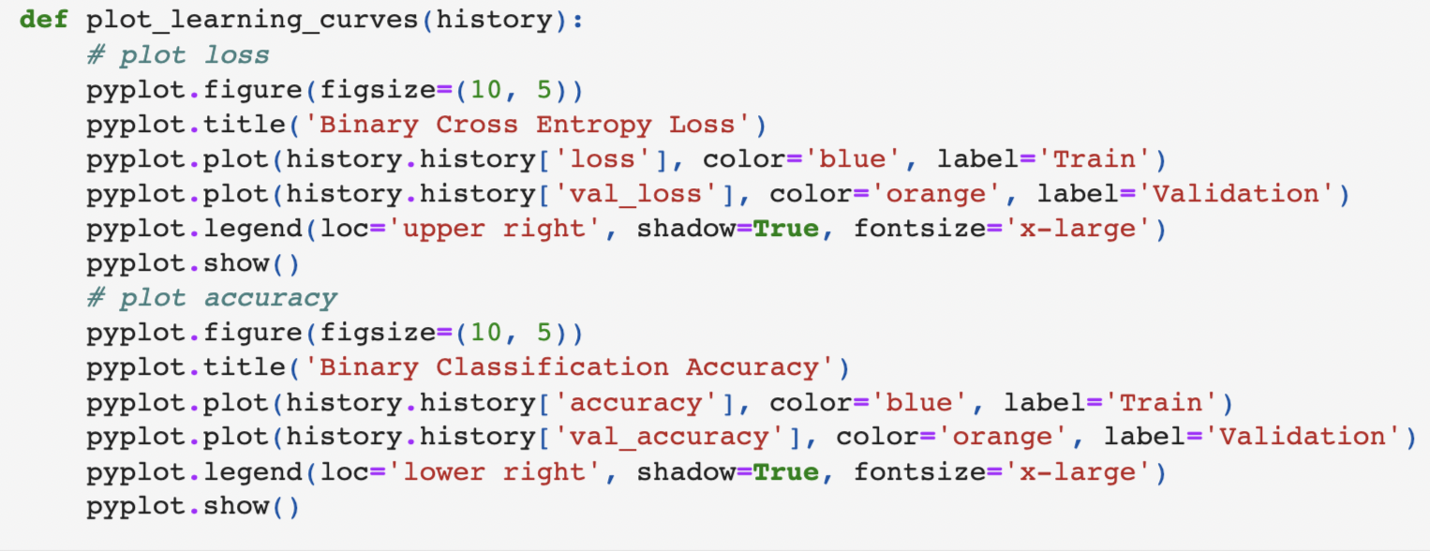
Function: Plot the Learning Curves
Binary Cross Entropy Loss
Binary Classification Accuracy

Slide 11
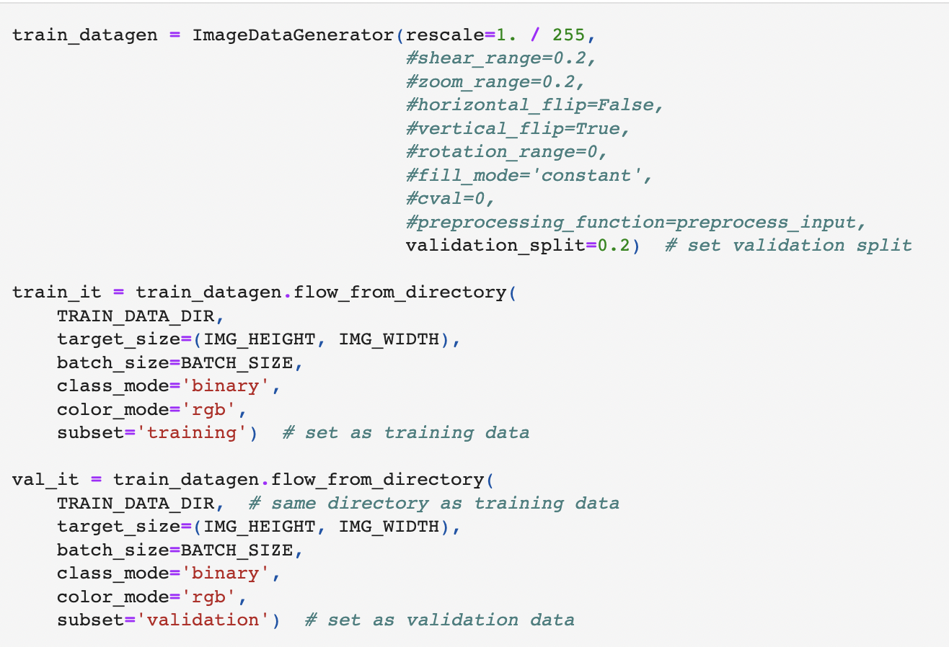
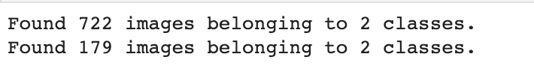
Creating a DataGenerator to Read in Images
train_datagen : Keras ImageDataGenerator that will split ≈20% of the training data for the validation data set
train_it : array of training data to feed into the CNN model, stores 722 rgb training images
val_it : array validation data that is a subset from the TRAIN_DATA_DIR , holds 179 rgb validation images.

Slide 12
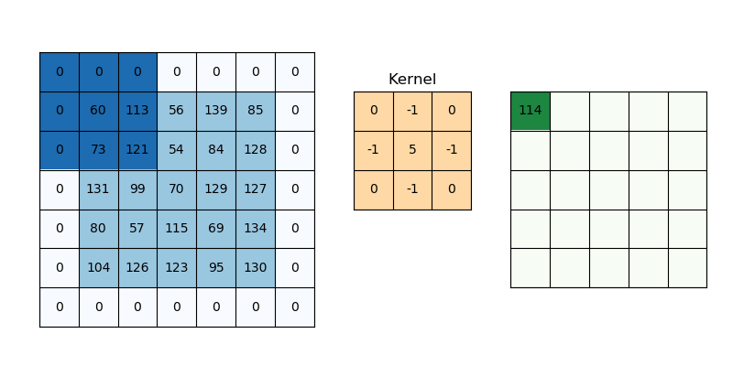
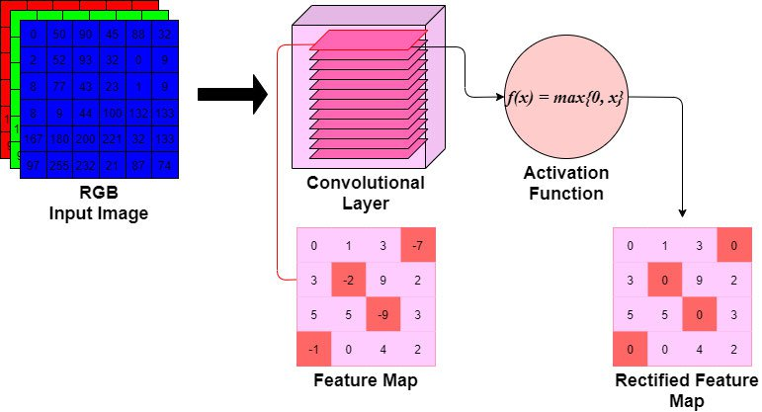
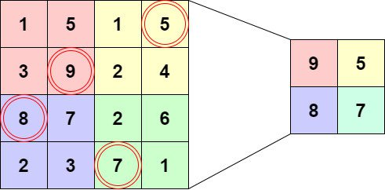
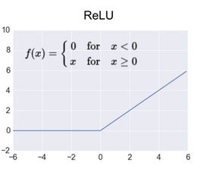
Convolution Neural Network Framework
Convolution Layer RELU activation MaxPool Layer
Input
Feature map

Slide 13
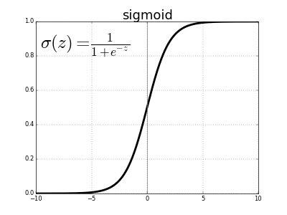
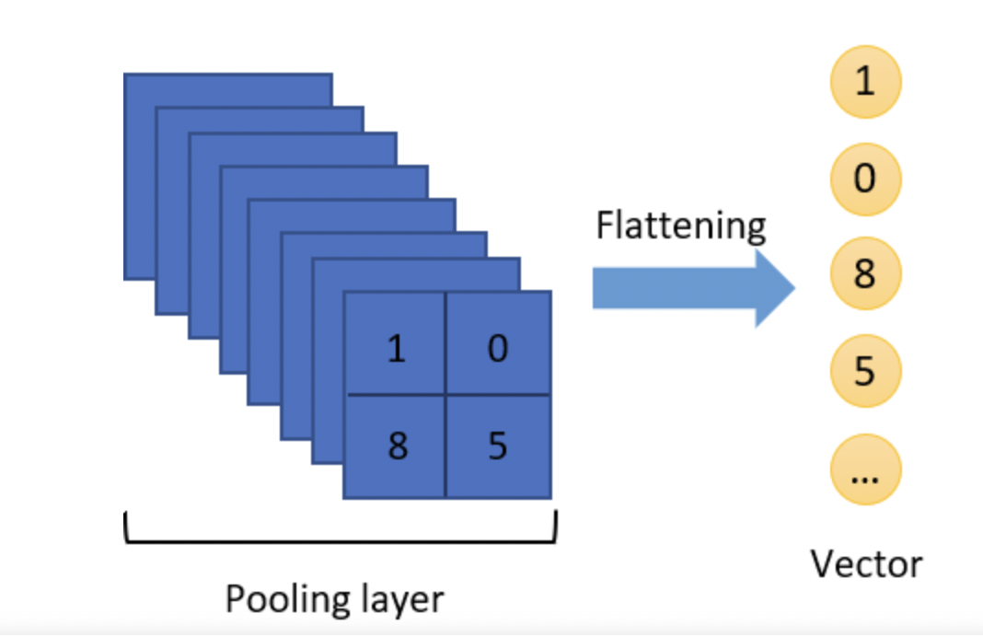
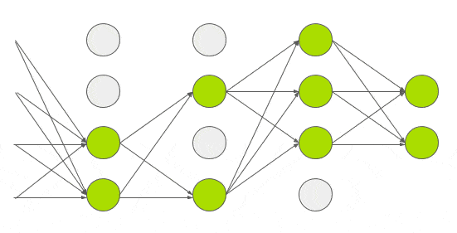
Convolution Neural Network Framework
Flatten Dense + Dropout Binary Classification

Slide 14
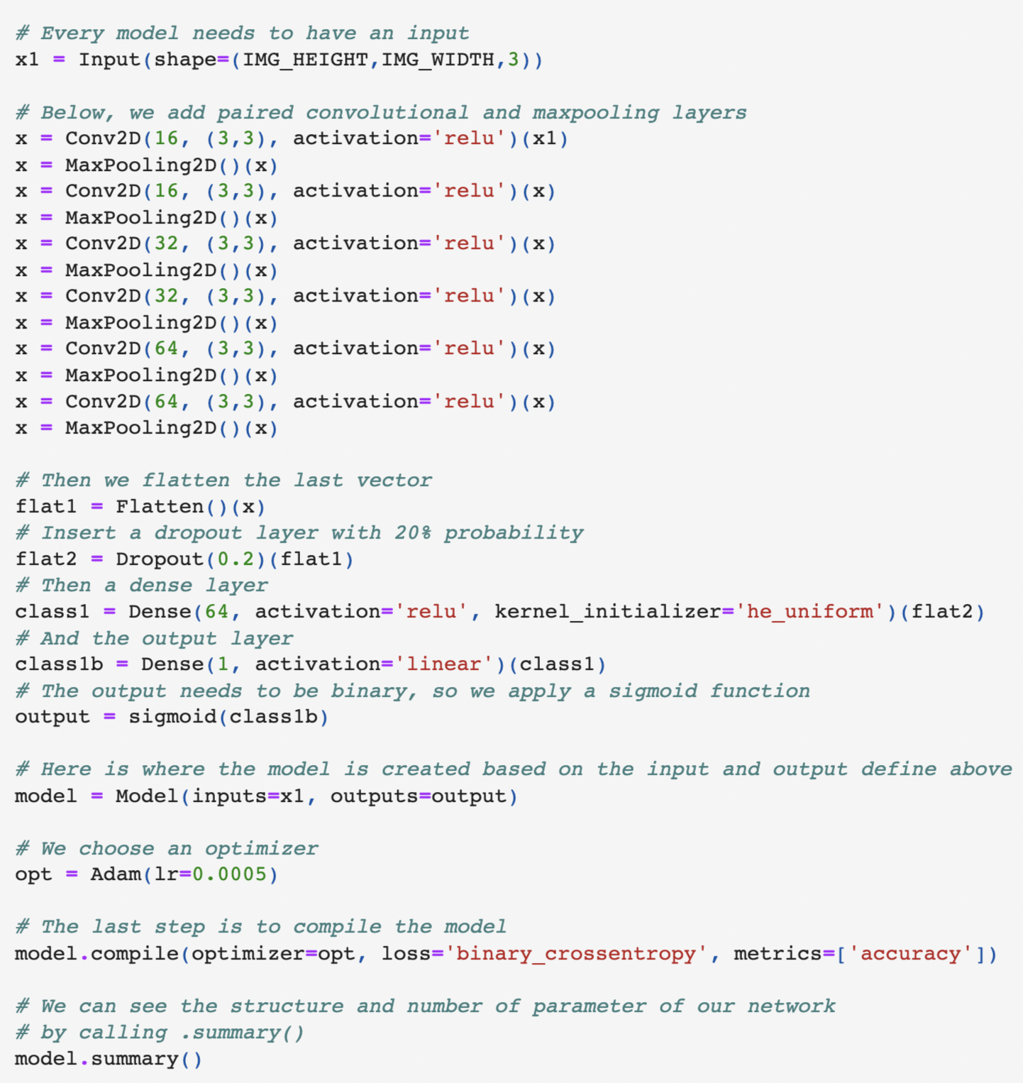
Setting up the CNN
Input : model input of shape (331x331x3) rgb images (x1)
Conv2D : creates a convolution kernel that is convolved with the layer input to produce a tensor (multi-dimensional array) of outputs
Activation : RELU, rectified linear unit, speeds up training with a simple gradient of 0 or 1, where all negative elements are set to 0 and computation is easy.
MaxPooling2D : results in pooled feature maps that highlight the most prominent feature in the patch, reducing dimension volume by half.
Flatten : flattens the multi-dimensional input tensors into a single dimension
Dropout : used to avoid overfitting the data
Notes:
conv2d(# of filters, (kernel size))
Kernel size = 3x3
Filter: integer parameter, numbers of filters the conv layer will learn from, determines the number of output filters in convolution

Slide 15
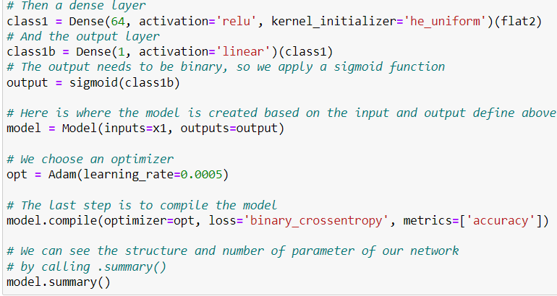
Setting up the CNN
Dense : used to create a fully connected model that receives all input from the previous layer
Kernel_initilaizer : ‘he_uniform’ draws samples from a uniform distribution (-limit, limit)
Output : sigmoid activation for binary classification
Model : inputs the keras.Input model, outputs the final layer of sigmoid function
Adam : extended stochastic gradient descent algorithm utilizing adaptive moment estimates
Model.compile : configures the model for training with arguments (optimizer = Adam gradient descent, loss = binary cross entropy, metrics = accuracy dictionary from sklearn library)

Slide 16
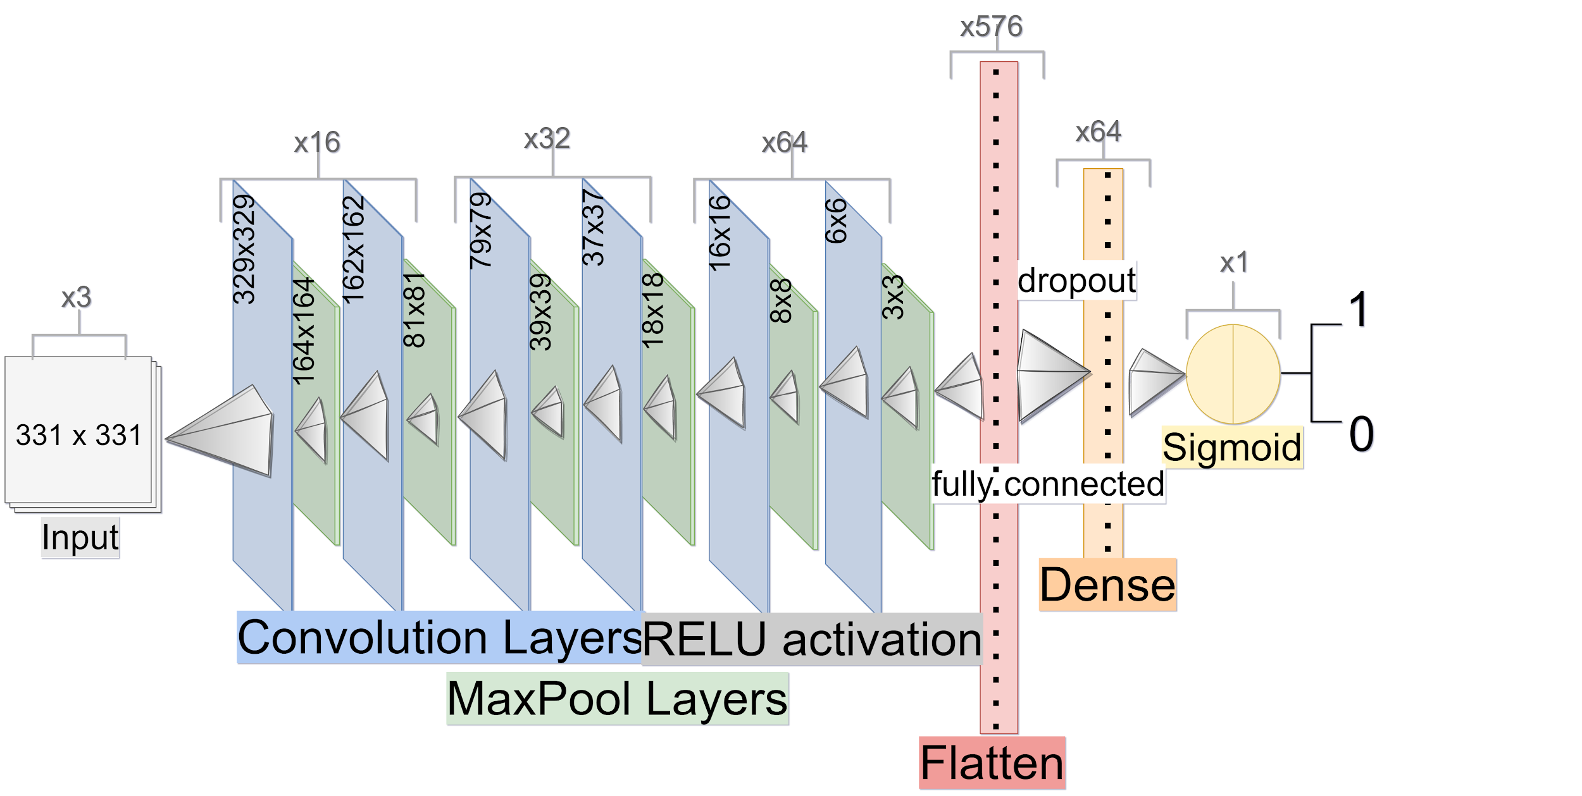
CNN Model Outline

Slide 17
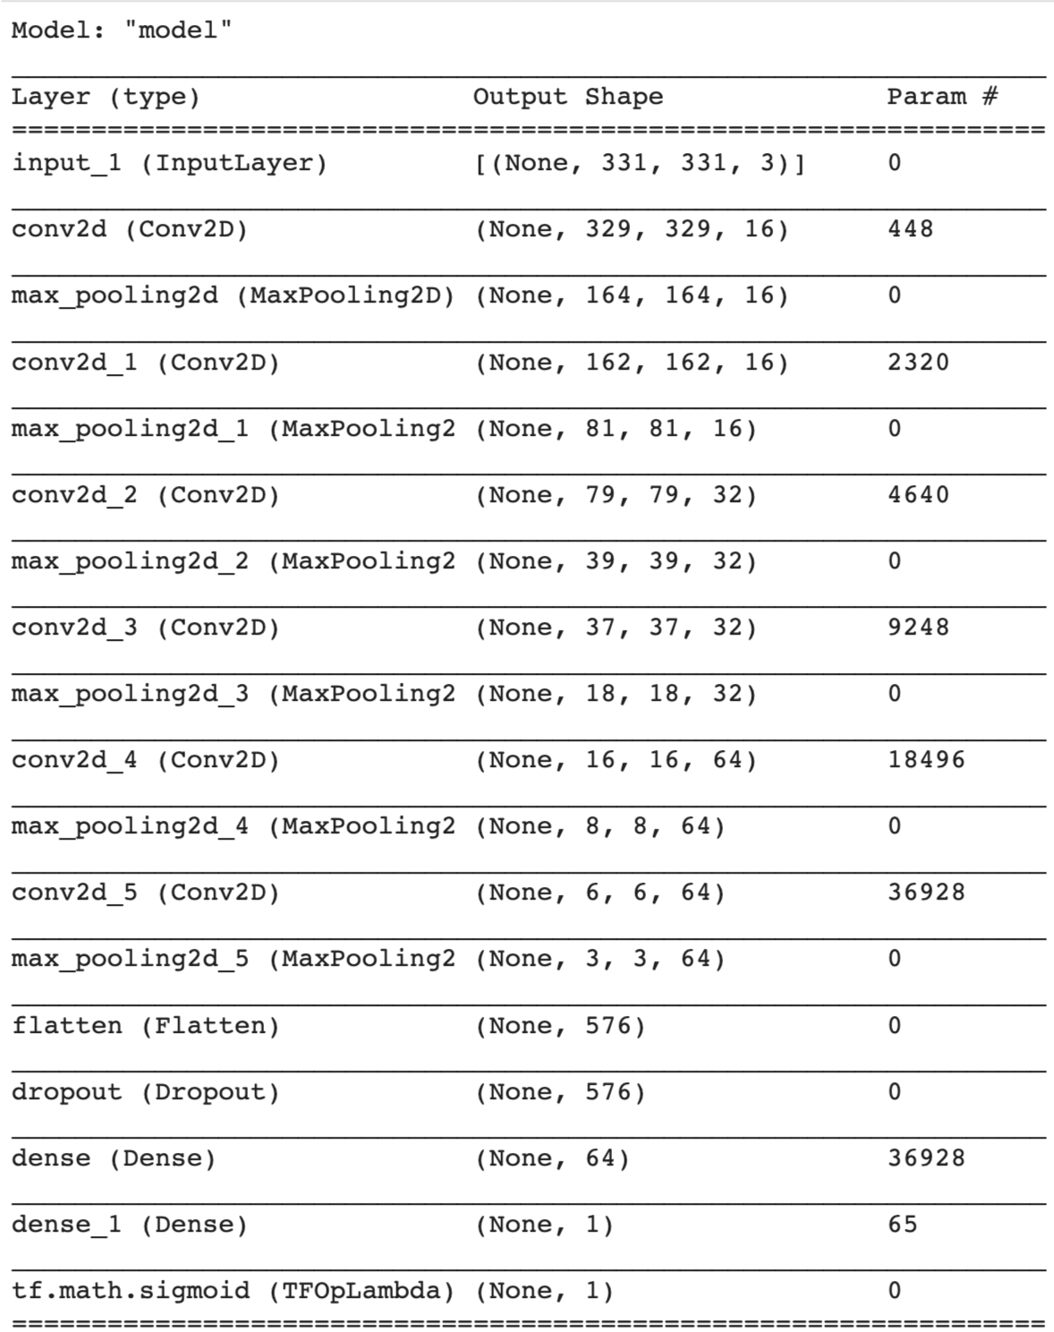
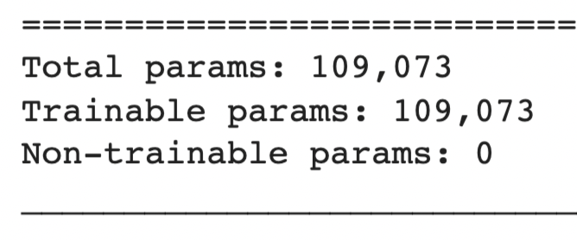
CNN Model Summary
Notes:
Total number of weights and biases for out model to learn from

Slide 18
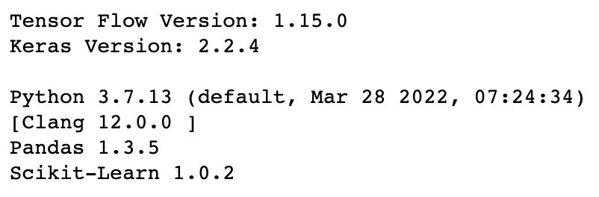
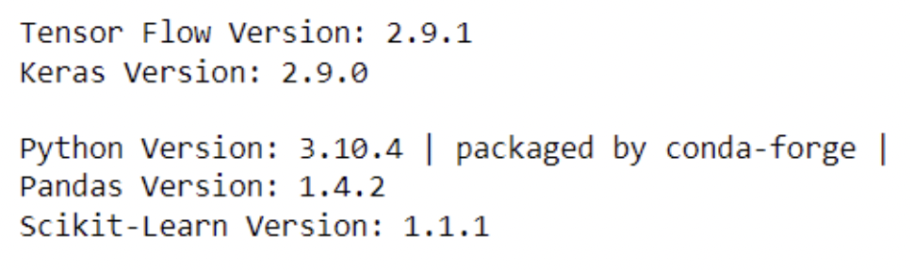
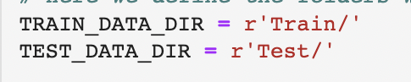
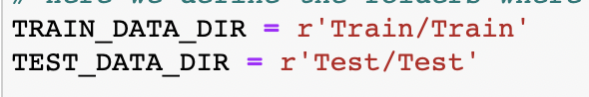
First Run Errors and how we fixed them
Original version
Our version

Slide 19
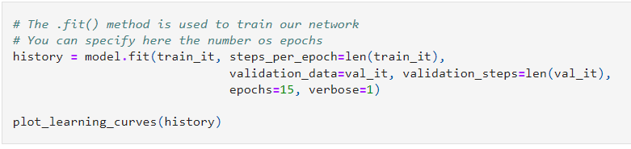
Training the Network
train_it : array of training data to feed our model
steps_per_epoch : total number of steps (batches of samples) to yield from generator before declaring one epoch done.
validation_data : array of data to evaluate the loss and any model metrics at the end of each epoch.
validation_steps : total number of steps to validate before stopping.
epochs : Number of epochs to train the model. (Go until this index is reached)
verbose : Verbosity mode (1 means show progress bar while training)

Slide 20
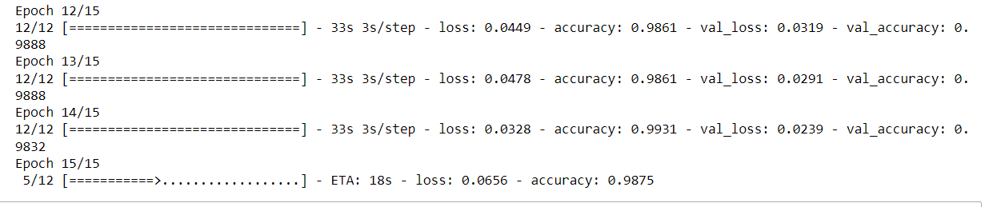
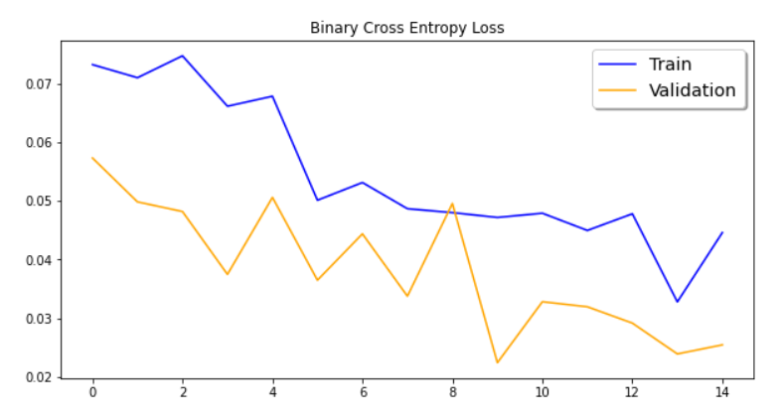
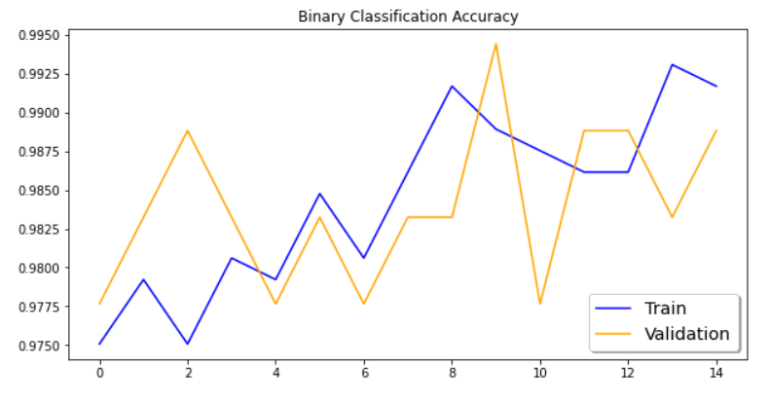
Continued (Not a Great Training)

Slide 21
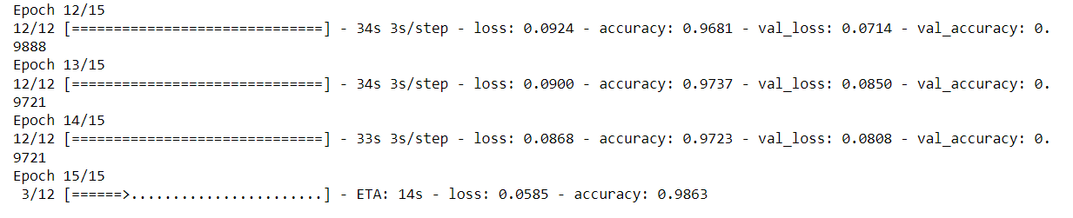
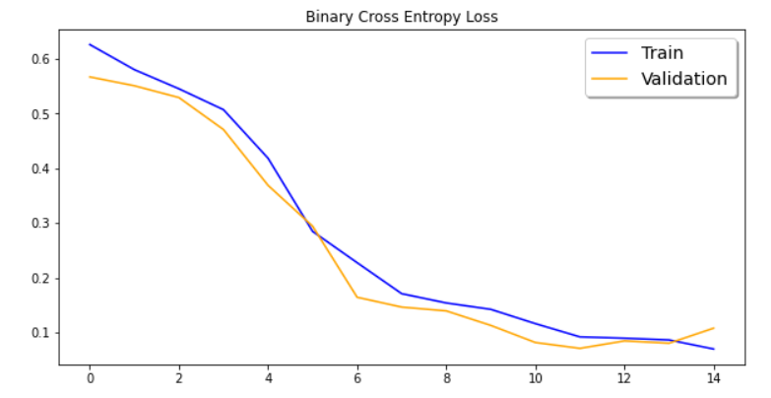
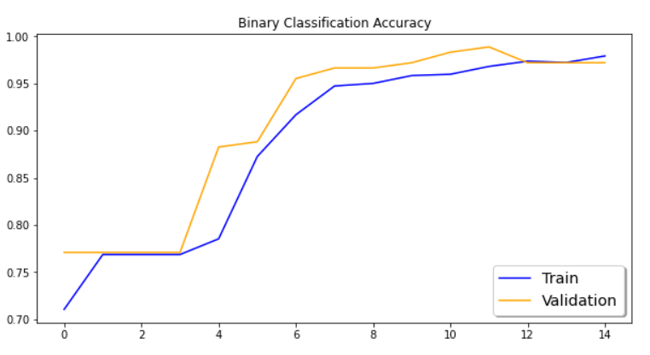
Continued (Better the Second Time)

Slide 22
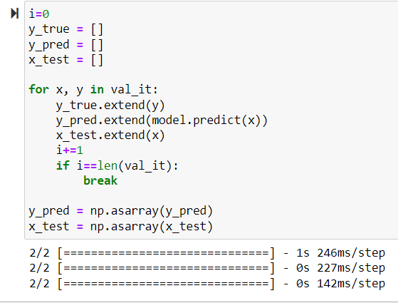
Predict the validation set/ performance metrics
Within the validation set:
Get all of the true y values (Y)
Get all of the predicted y values (Ŷ)
Run the Network Model and get all of the x values used to make predictions to test the accuracy of the model.
Continue until we reach the end of the validation set
Store the Y and X values in numpy arrays

Slide 23
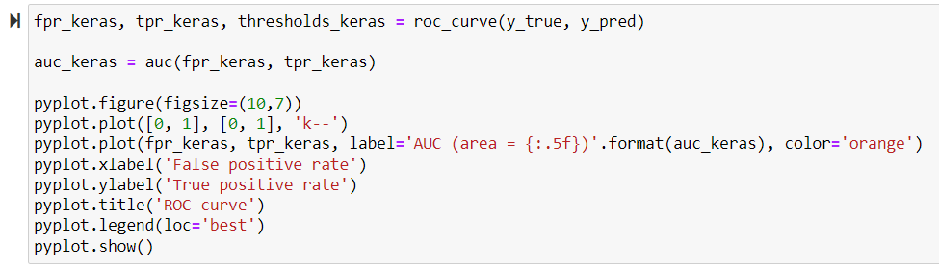
Plot the ROC Curve for Validation Data
From the sklearn library
roc_curve : Compute Receiver Operating Characteristic (ROC).
– Parameters –
y_true : True binary labels (Values are expected to be 0 or 1) (Expectation – Y)
y_pred : Target scores (Values determined by the network) (Reality – Ŷ)
– Returns –
fpr_keras : Array of increasing false positive rates
tpr_keras : Array of increasing true positive rates
thresholds_keras : Array of decreasing thresholds on the decision function used to compute fpr and tpr.

Slide 24
Plot the ROC Curve for Validation Data
From the keras library
auc : Approximates the AUC (Area under the curve) of the ROC
– Parameters –
fpr_keras : Array of increasing false positive rates
tpr_keras : Array of increasing true positive rates
– Returns –
auc_keras : an approximation of the area under the positive rates curve

Slide 25
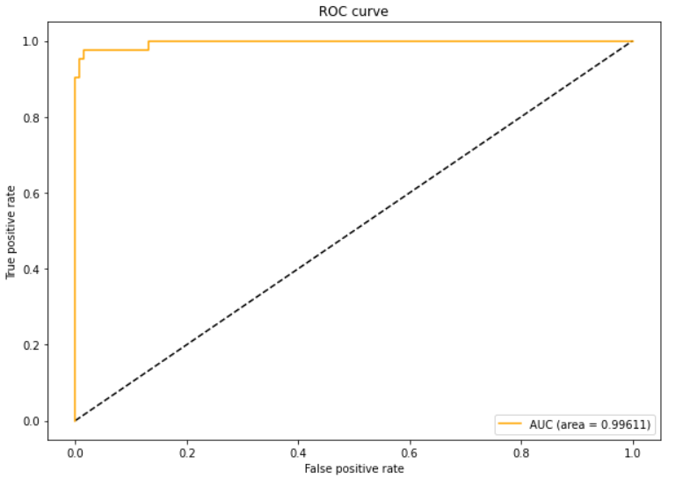
Plot the ROC Curve for Validation Data

Slide 26
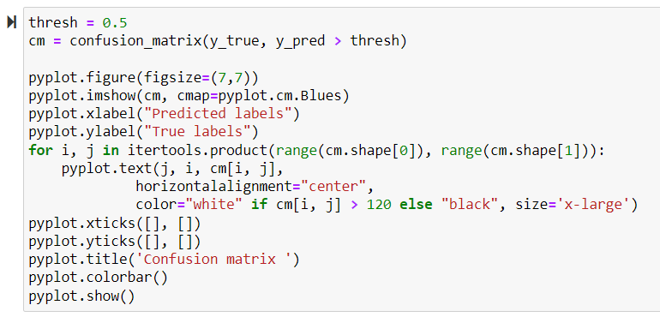
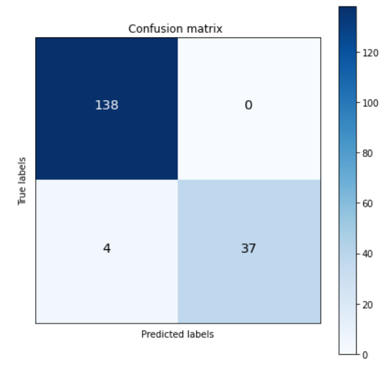
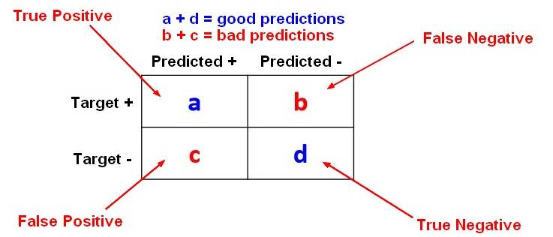
Plot Confusion Matrix for Validation

Slide 27
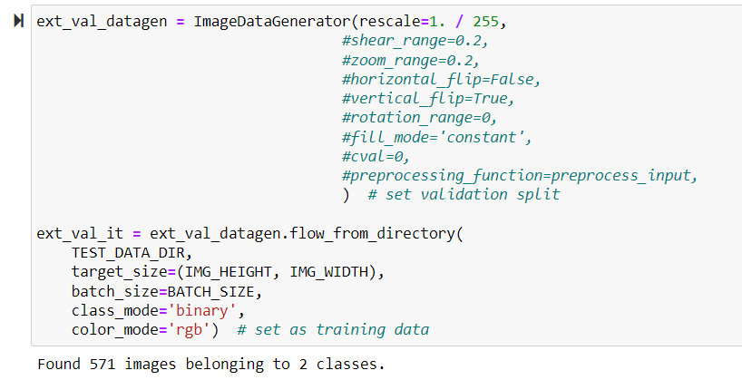
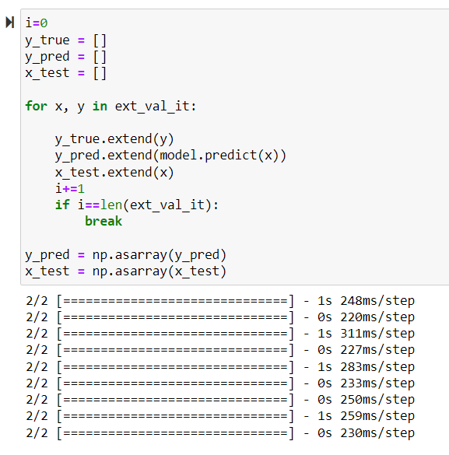
Predict the Test Set

Slide 28
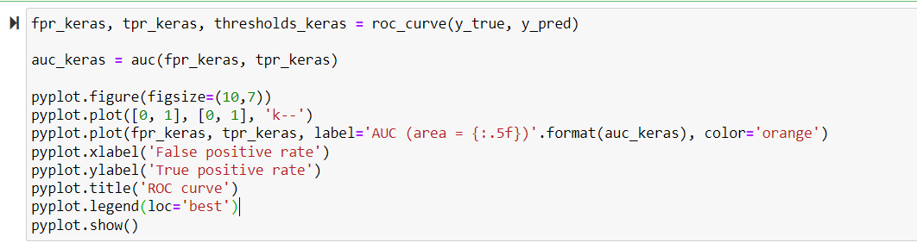
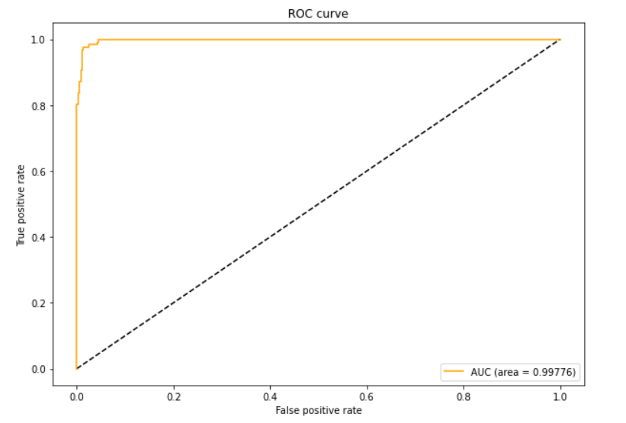
Plot ROC curve for Test Set

Slide 29
Comparison ROC of Validation With Test
Validation Data Results
Test Data Results

Slide 30
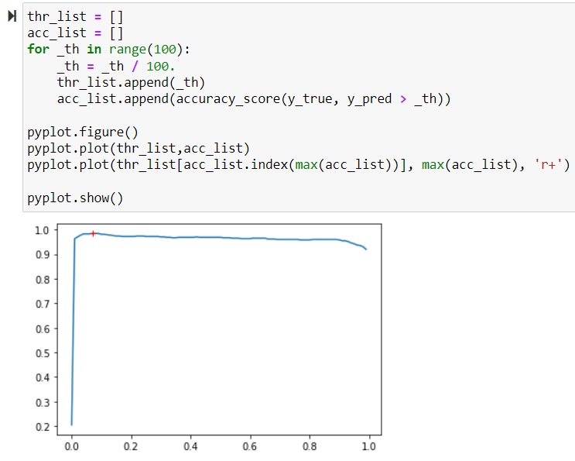
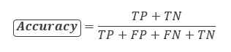
Find threshold with the best accuracy
What range was our network the most accurate when giving out its predictions

Slide 31
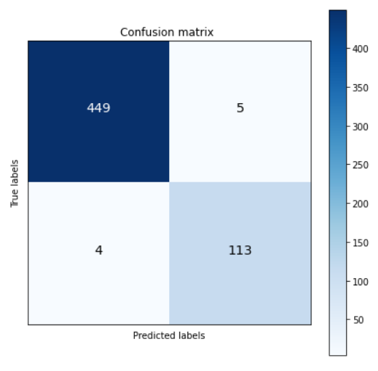
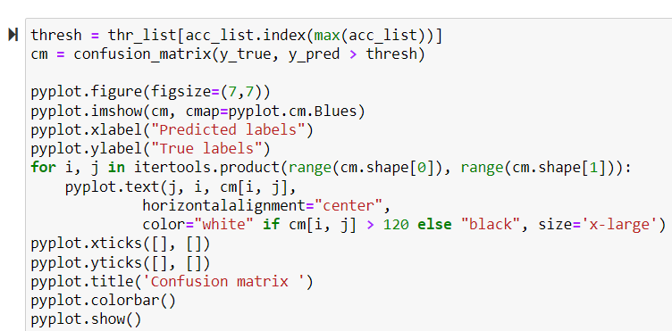
Plot the Confusion Matrix for the Test Set

Slide 32
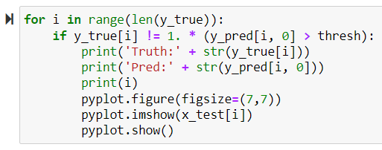
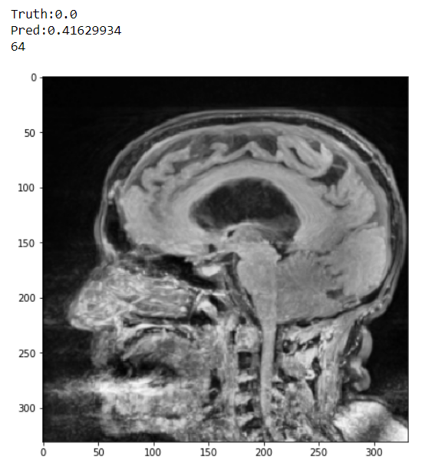
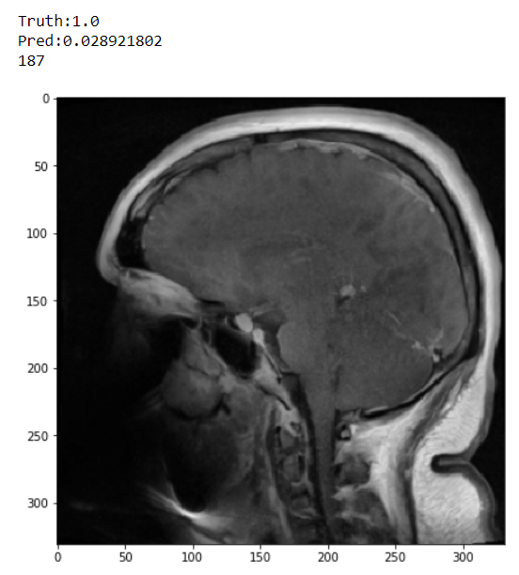
Displaying Cases Model Predicted Incorrectly

Slide 33
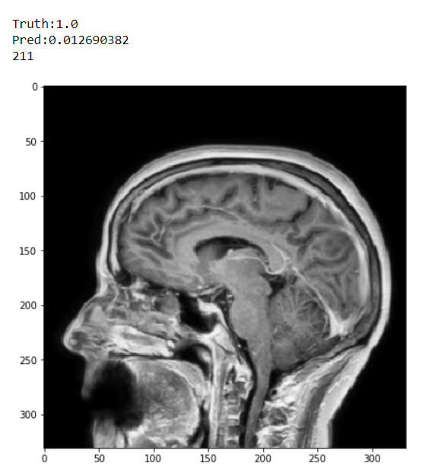

Display Cases Model Predicted Incorrectly

Slide 34


Display Cases Model Predicted Incorrectly

Slide 35




Slide 36
Conclusion
Medical Imaging is a productive field to be considered for application of deep learning techniques
Binary Classification can be used to determine whether a T1 MRI scan consists of Pre- or Post-Contrast
Each time the CNN is fitted and trained, its threshold and accuracy varies despite using the same training, validation, and testing data.
The model that we fit to observe T1 MRI scans did contain perfect predictions; however, its errors were significantly lower than its correct guesses during the majority of running the notebook
The model gives insight into how a CNN operates and the methods and libraries used in standard practices to produce statistical observations pertaining to medical imaging

Slide 37
Questions?
References
https://github.com/ImagingInformatics/machine-learning/blob/master/Education/KerasBinaryClassifier/SIIM_Keras_Binary_Classifier.ipynb
https://machinelearningmastery.com/difference-between-a-batch-and-an-epoch/
https://www.ncbi.nlm.nih.gov/pmc/articles/PMC2698108/
https://machinelearningmastery.com/threshold-moving-for-imbalanced-classification/
https://www.geeksforgeeks.org/keras-conv2d-class/
https://data-flair.training/blogs/keras-convolution-neural-network/
https://towardsai.net/p/machine-learning/beginner-guides-to-convolutional-neural-network-from-scratch-kuzushiji-mnist-75f42c175b21

